Slide 1
Careers Morning
2023

Slide 2
Higher and Degree Apprenticeship Options

Slide 3
Examples of Sectors & Industries
Offering Apprenticeships
Creative, media, arts, and digital technologies – advanced, higher, degree
Information and communication technology – advanced, higher, degree
TV production and broadcasting – advanced, higher, degree
Business management, administration, law, and financial services – advanced, higher, degree
Construction, planning, and the built environment – advanced, higher, degree
Engineering and manufacturing – advanced, higher, degree
Health and care – advanced, higher, degree
Life and industrial sciences – higher, degree
Retail and commercial enterprise – advanced, higher
Agriculture, horticulture, and animal care – advanced, higher
Public sector/public services – advanced, higher
Education and training – advanced
Leisure, travel, and tourism – advanced
Notes:
Each sector shows what levels of apprenticeship is currently available. (taken from UCAS.com Feb 2020)

Slide 5
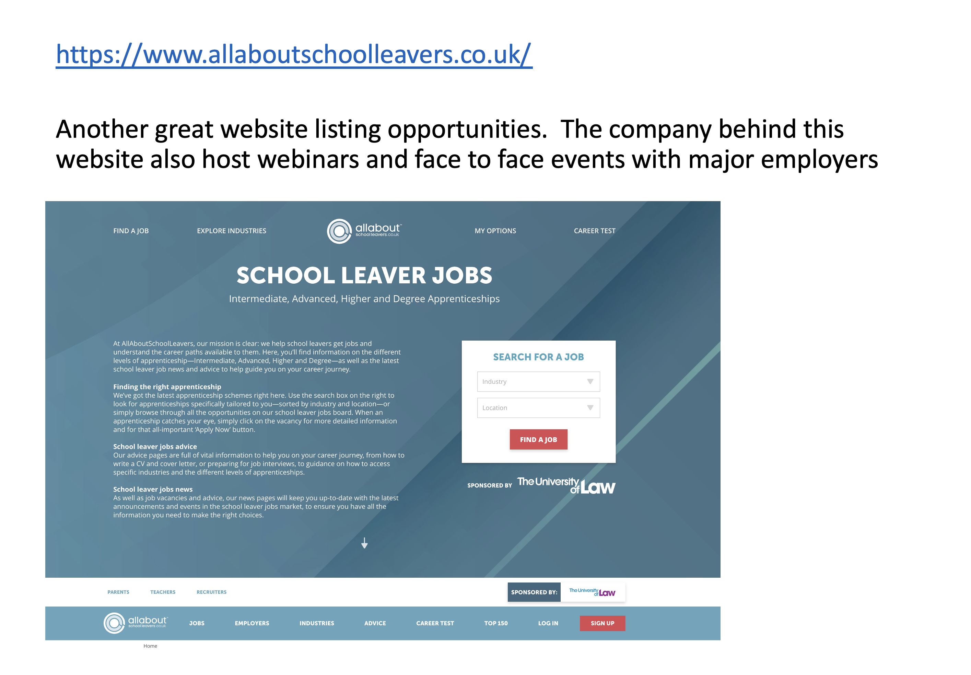

Slide 6
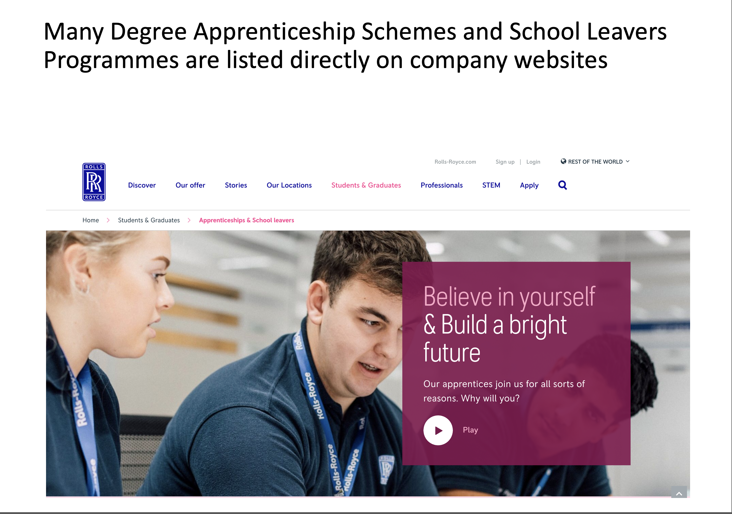

Slide 9
UCAS
How does it work ?

Slide 10
Radyr Sixth Form - UCAS Statistics
In 2011- 86% of students who applied ended up at university
In 2012- 89% of students who applied ended up at university
In 2013 and 2014- 98% of students who applied ended up at university
Since 2015- 99% of all students who applied ended up at university

Slide 11
Russell Group Success
In 2012 – 24.8% of students obtained places at Russell Group Universities
In 2013 and 2014 – 35% of students obtained places at Russell Group Universities
Since 2015 between 51-57% of students obtained places at Russell Group Universities.
In 2022- 69% of our year 13 students have at least 1 offer from a Russell Group university

Slide 12
How does it work ?
You complete an online form. It is made up of your;
Personal details
Education – GCSEs, AS & A levels & others
Choices – research needed
Personal statement – may need help !
Reference

Slide 13
What do we do ?
Look at the form online to keep an eye on progress
Add a reference/predicted grades
Check the form for obvious mistakes
Return forms with (instructions)
Send it off to UCAS (point of no return !)
Acknowledged by UCAS
You follow progress via ‘track’
Offers start to flood in (we hope)

Slide 14
UCAS Official Deadlines
Most people Jan 25th at UCAS
Oxbridge, Vets, Medics and Dentists October 15th at UCAS

Slide 15
Deadlines - ours
Oxbridge, Vets, Medics and Dentists by Friday 16th September
All other applicants Friday 11th November

Slide 16
Why are Radyr deadlines earlier?
To ensure your applications are completed on time.
To give you an advantage over other applicants who are applying.
The earlier your application is sent off, the earlier you start receiving offers and the more chance you have of getting on to your first choice courses.

Slide 17
UCAS Points Offers
About 30% of universities give points offers.
The UCAS points being awarded for qualifications changed this year.
For example an A grade at A level or a distinction at BTEC was worth 120 pts. It is now worth 48 pts.

Slide 18
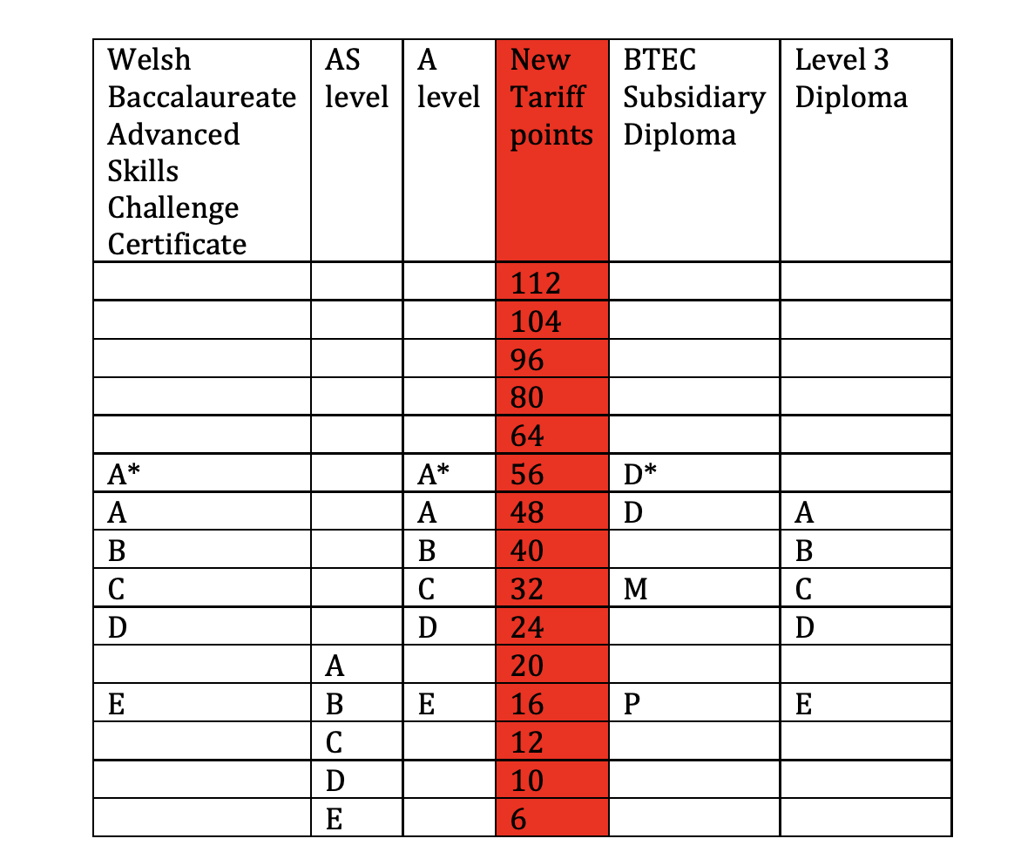

Slide 19
Now watch the following video clips to learn more about the application process and in particular the personal statement

Slide 20
Support
Talks/webinars from universities
Sessions on personal statements
Sessions on UCAS website
Mentoring sessions with your form tutor and 6th Form team
All support materials are available online
Radyr UCAS Guide
Radyr Careers and University Resources Guide

Slide 25
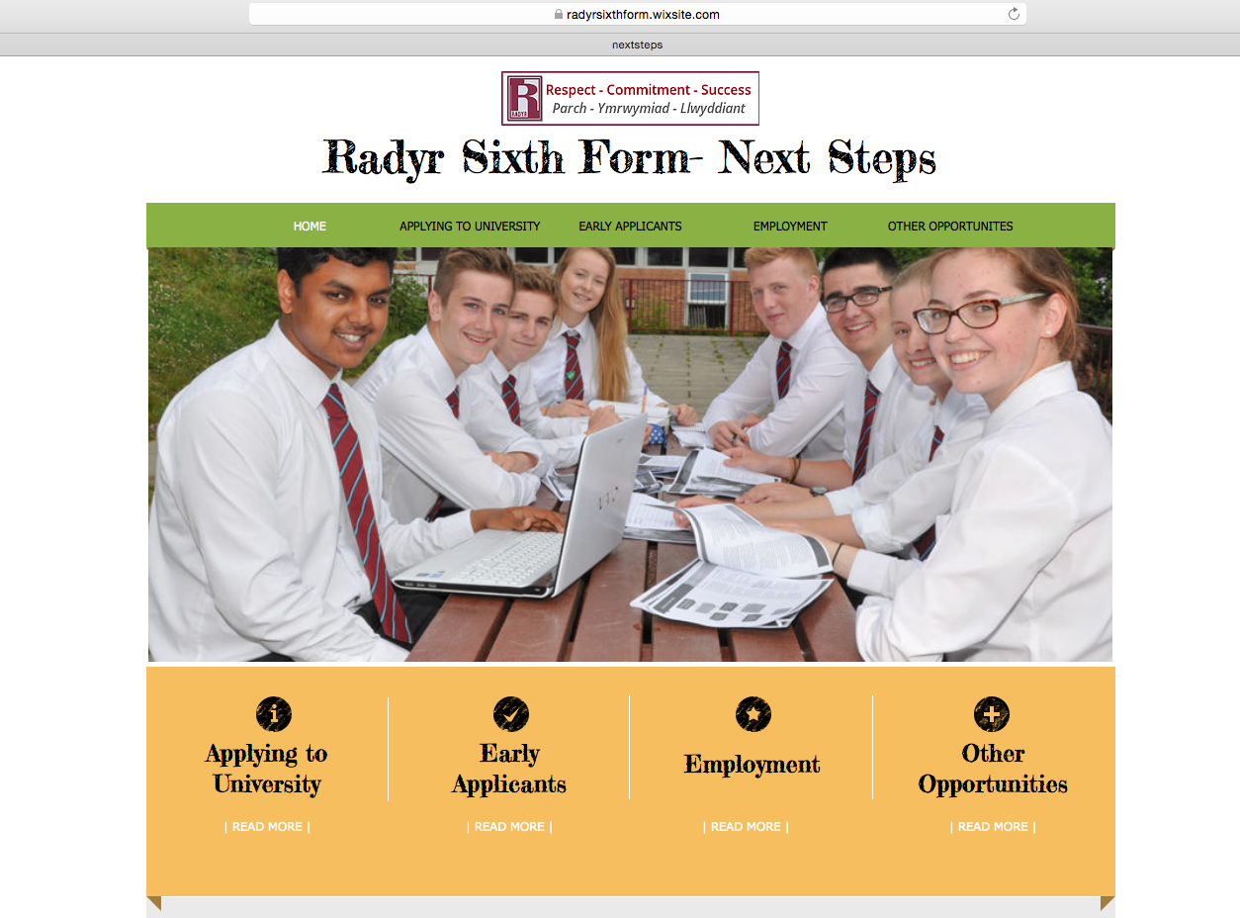

Slide 26
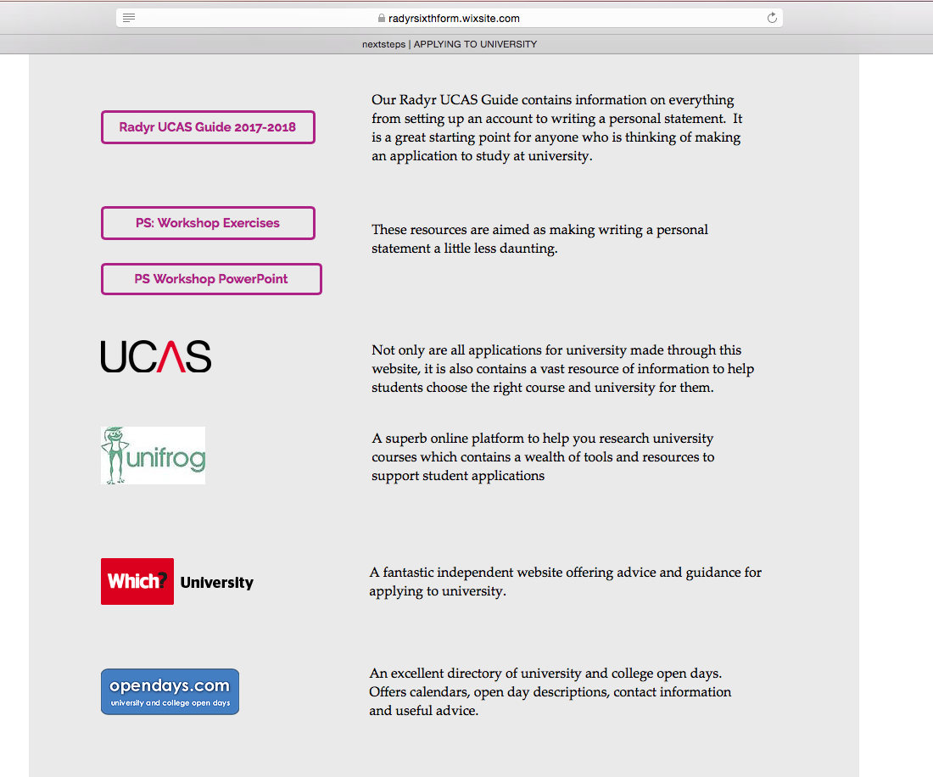

Slide 27
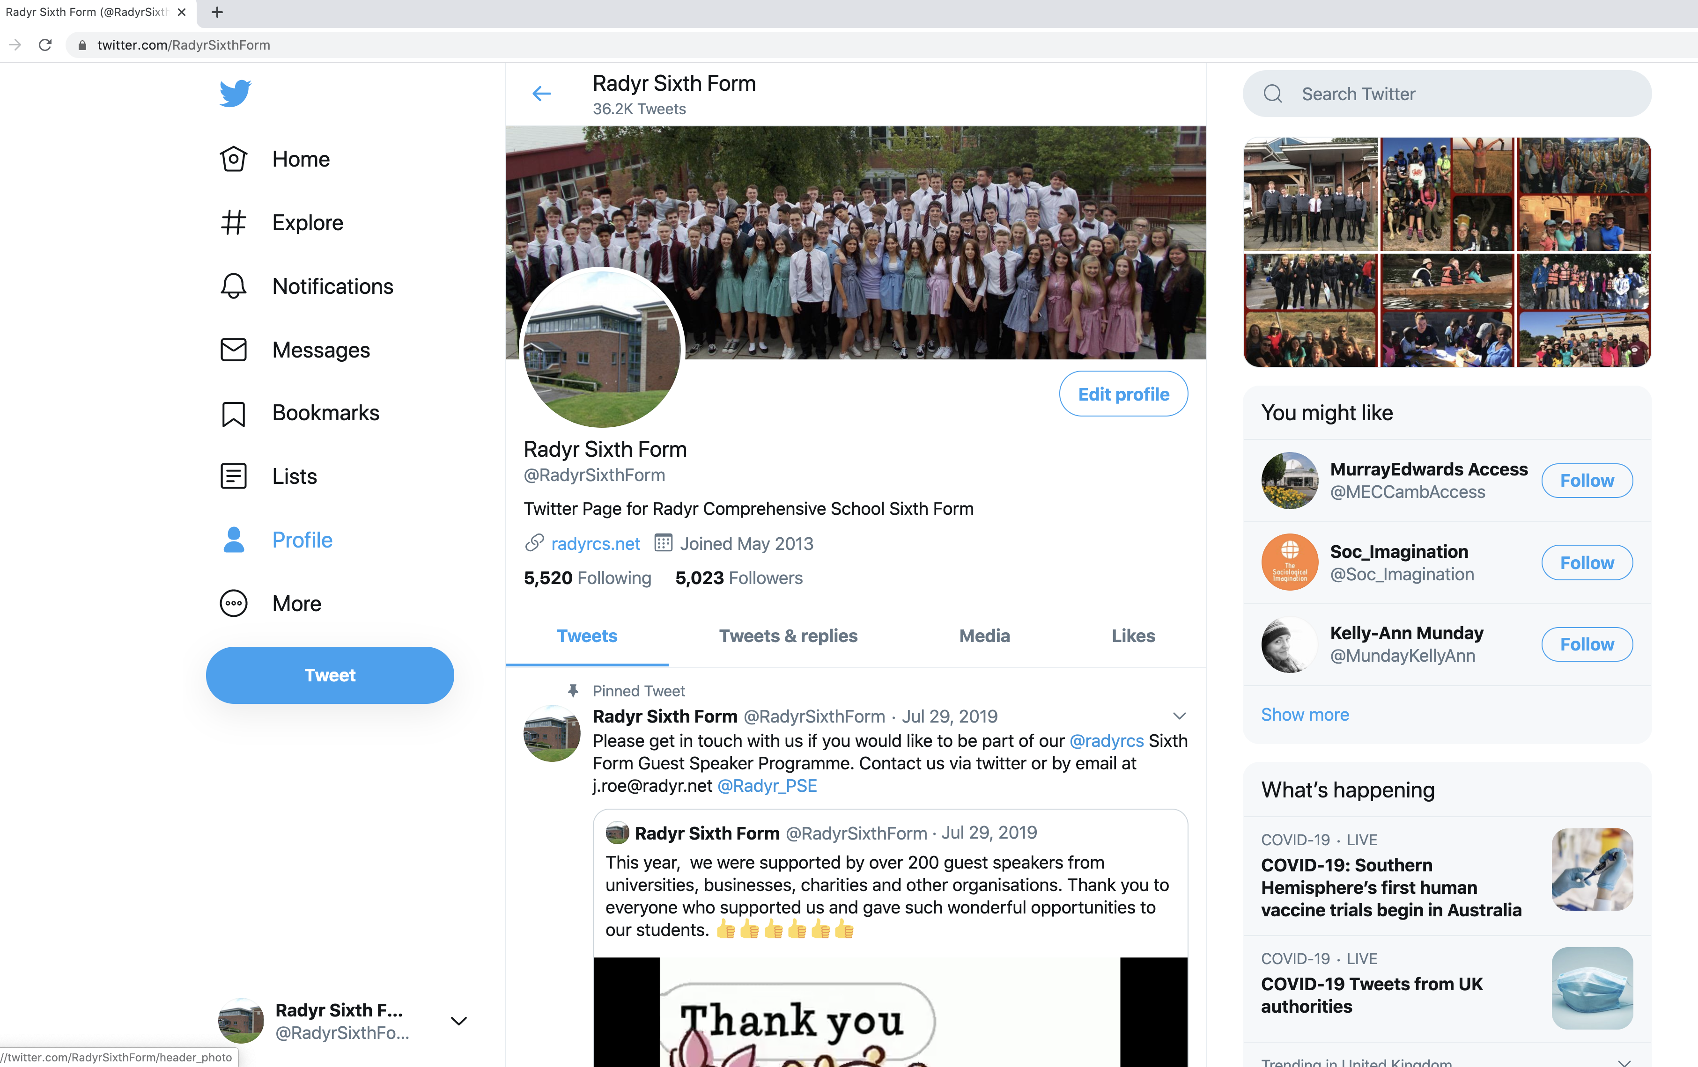
Radyr Sixth Form Twitter Site @RadyrSixthForm

Slide 28
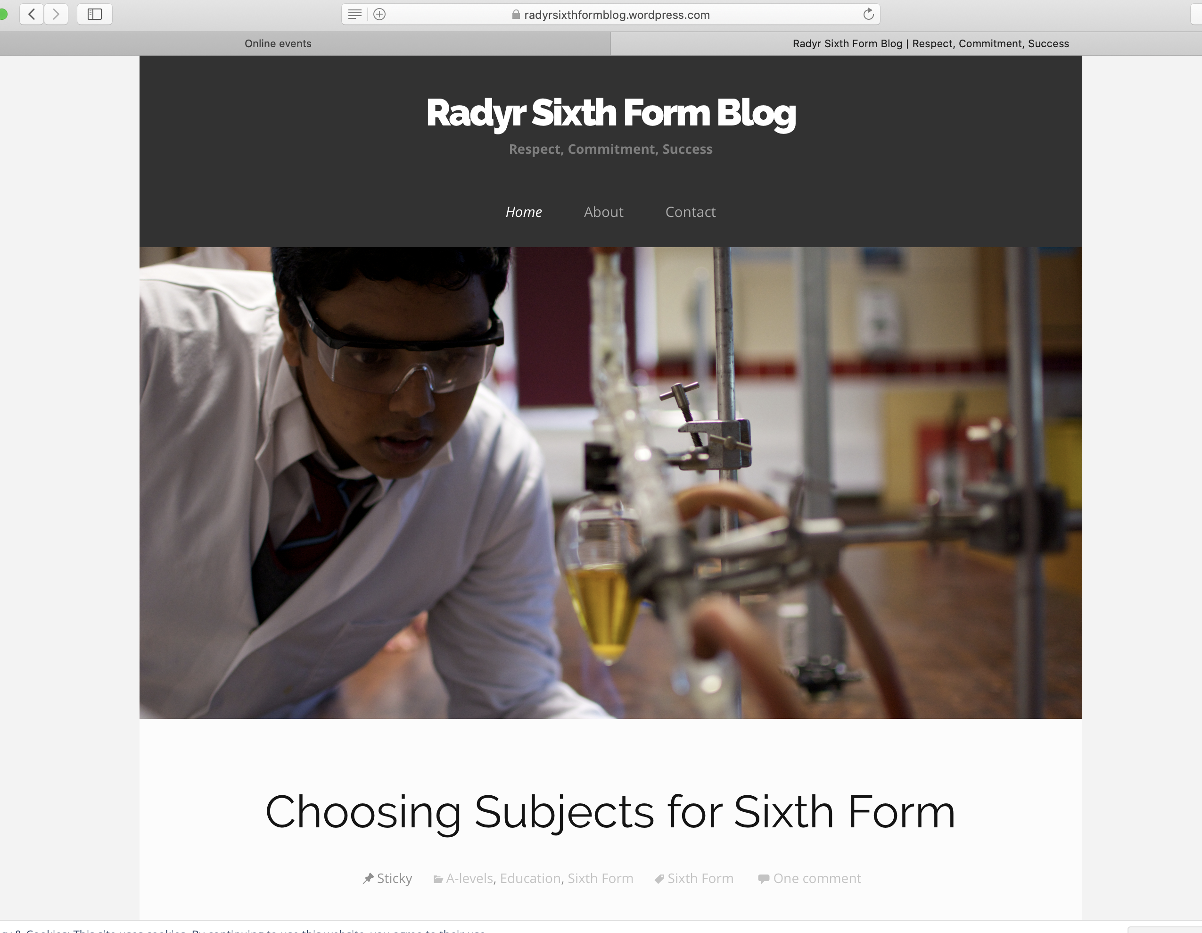

Slide 29
What should you be doing now ?
Research courses & universities – lots of online resources are available to support you with this.
Attend virtual Open Days/webinars to find out more about these courses.
Explore recommended super-curricular resources such as MOOCs for the subjects you are interested in.
Discuss ideas with tutors, subject teachers & parents/guardians.

Slide 32
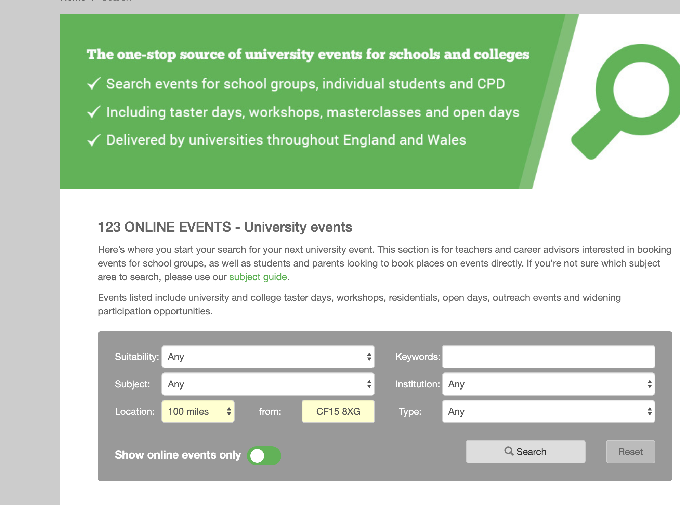

Slide 33
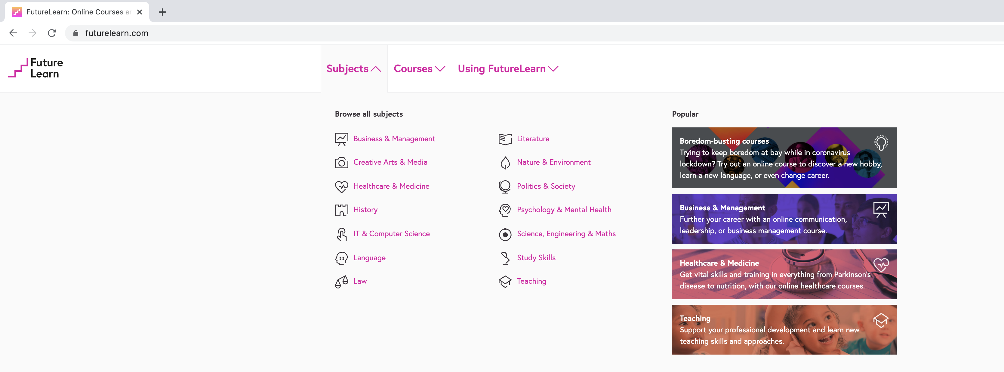

Slide 34
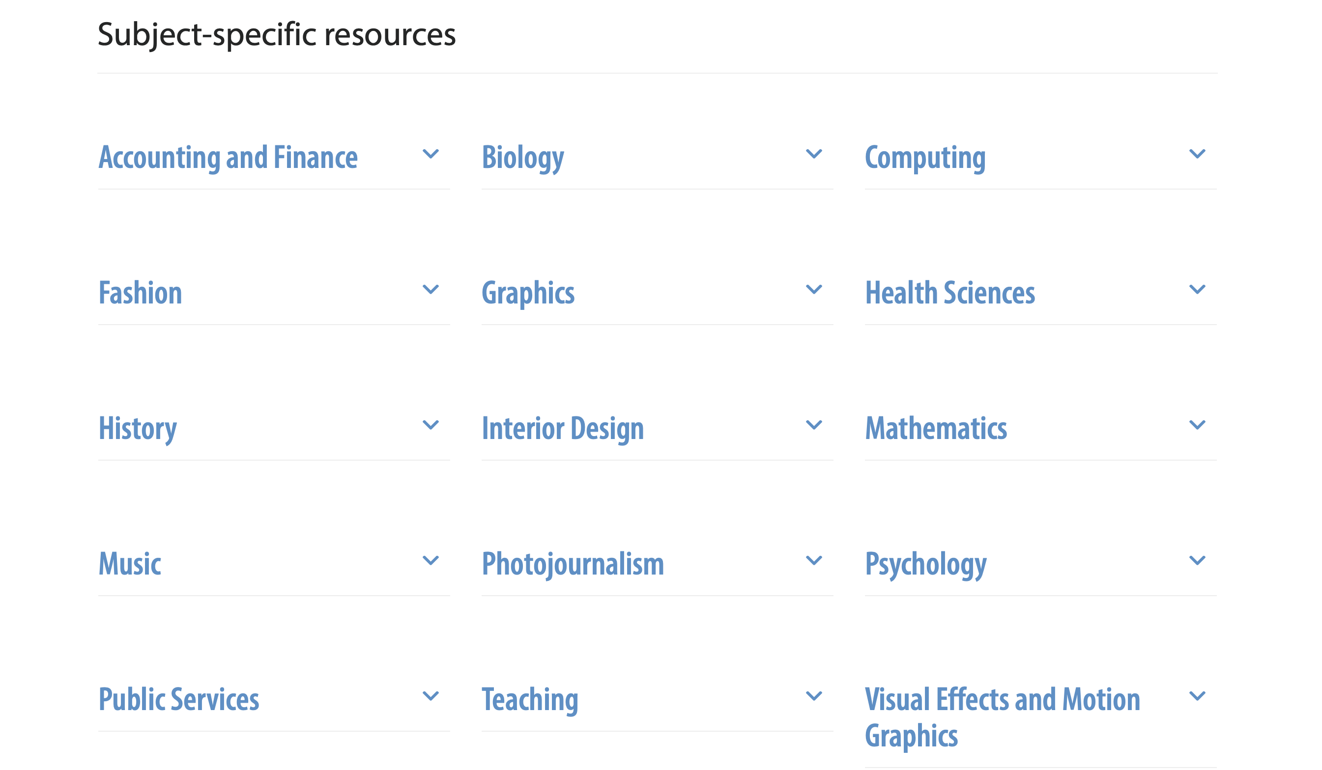

Slide 35
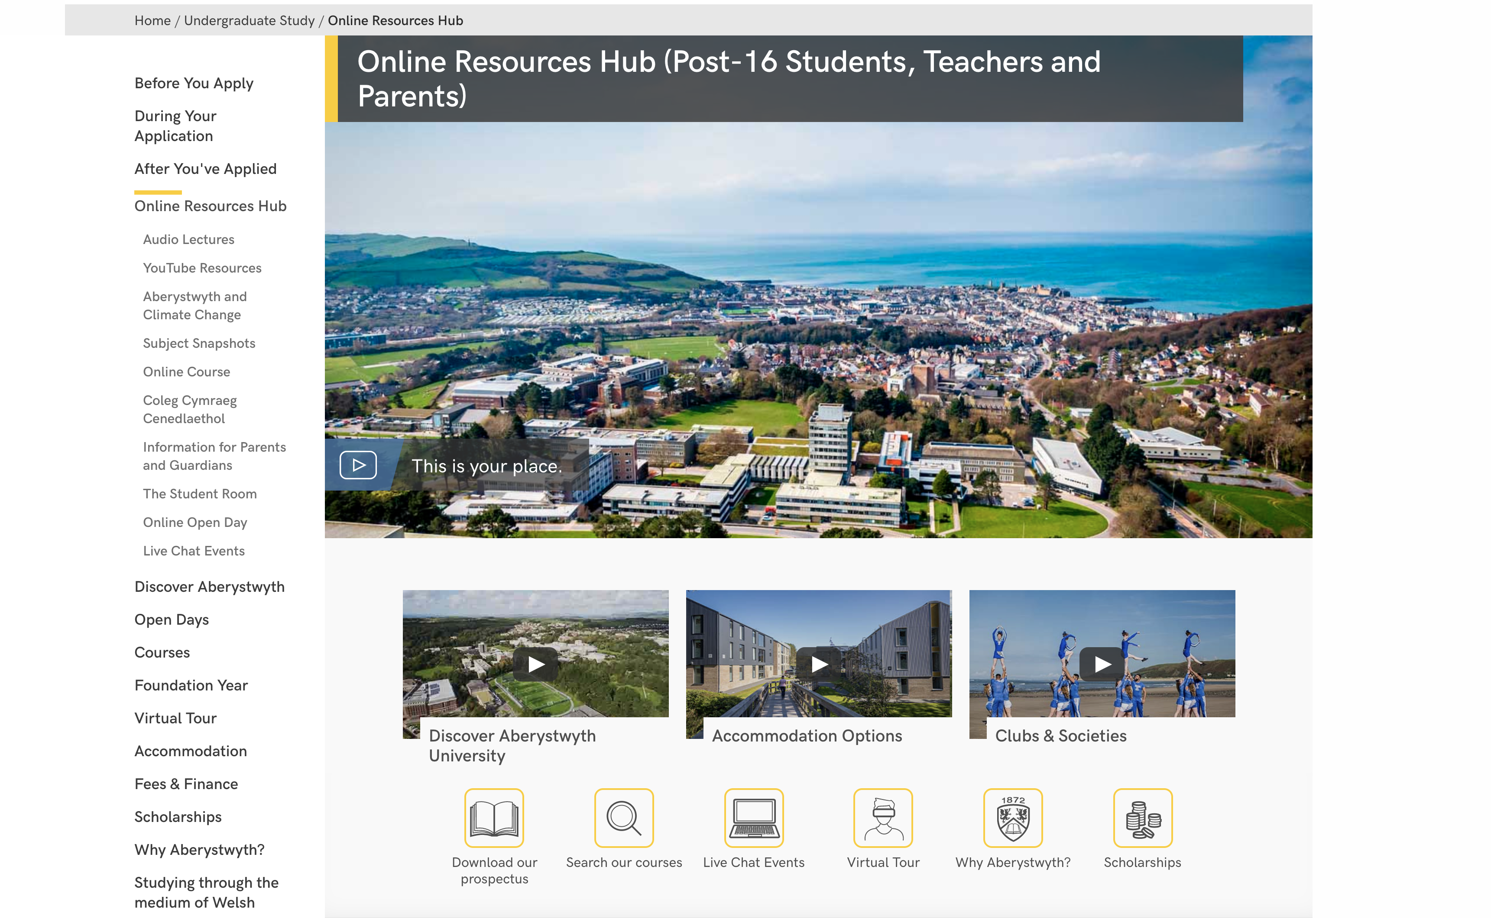

Slide 36
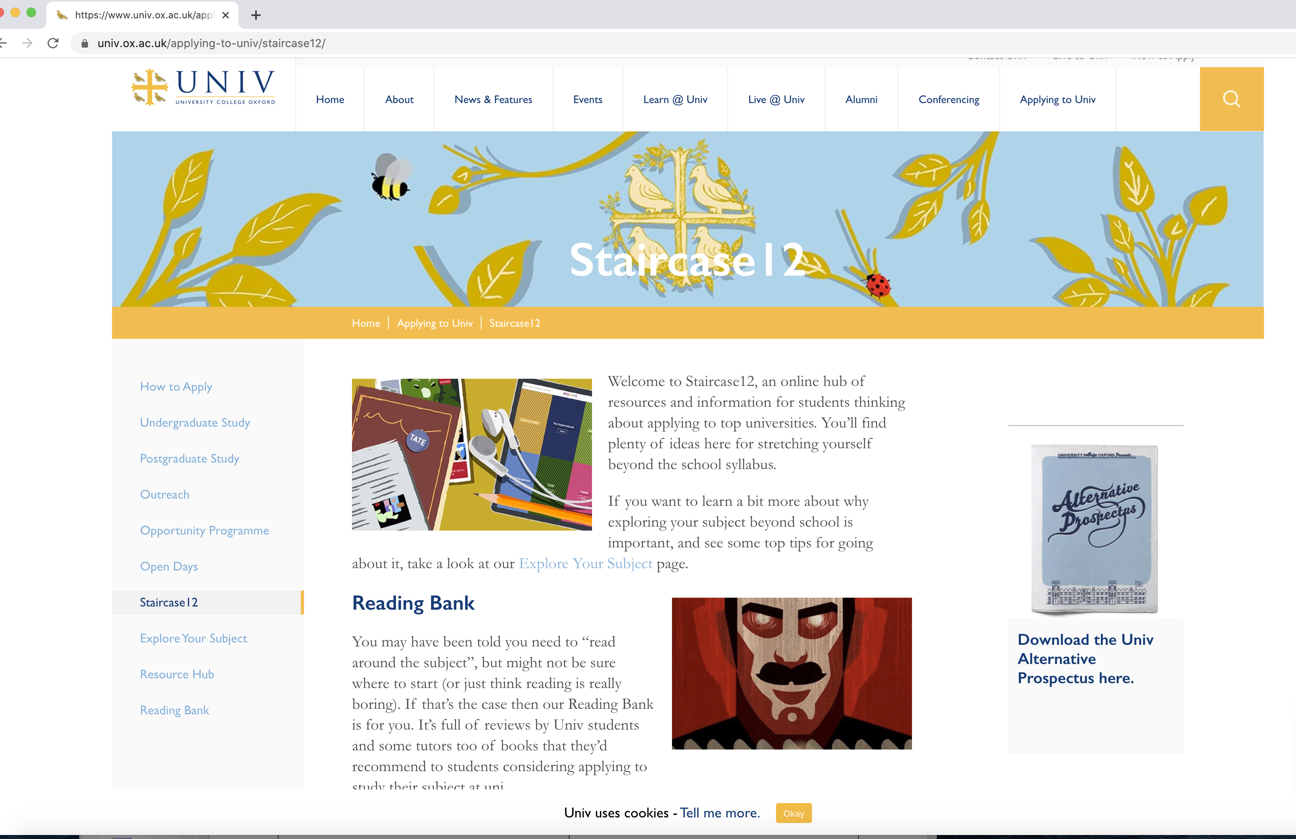

Slide 37
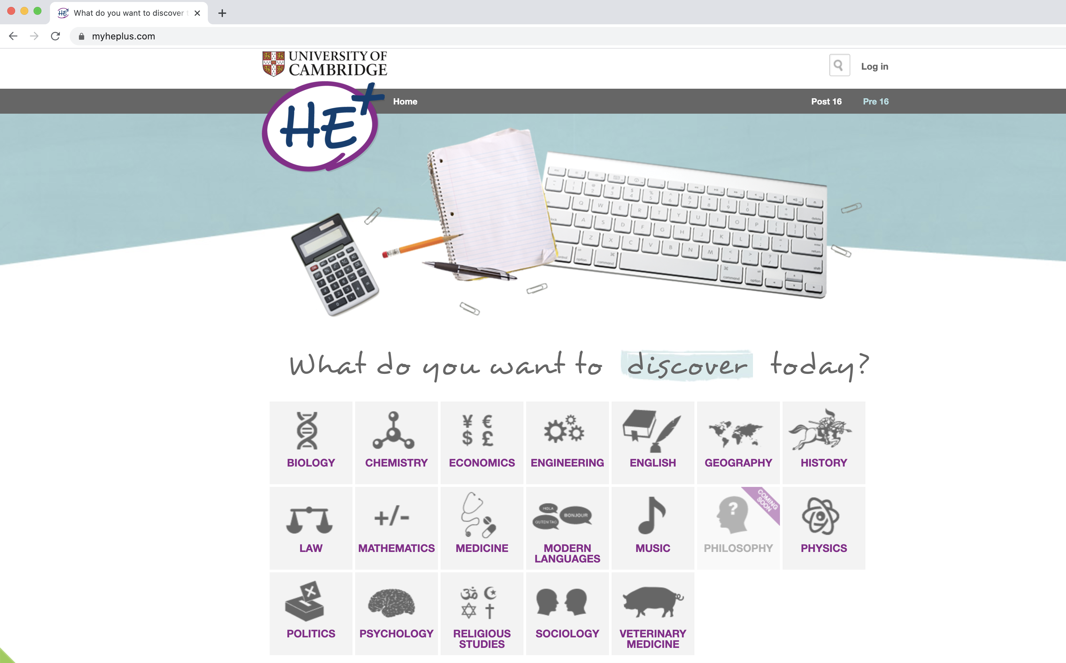

Slide 38
Over the next month or so
Visit universities if you can. Attend Open Days, taster events, summer schools etc.
Create long lists, then short lists
Start to construct your personal statements
Consider any extra requirements such as volunteering or work experience.
Please note
Courses that usually require work experience such as medicine will be aware that it is difficult for students to undertake work experience in a health care setting. Take advantage of opportunities such as virtual work experience schemes or volunteering opportunities (as long as you feel safe and comfortable doing so).

Slide 40
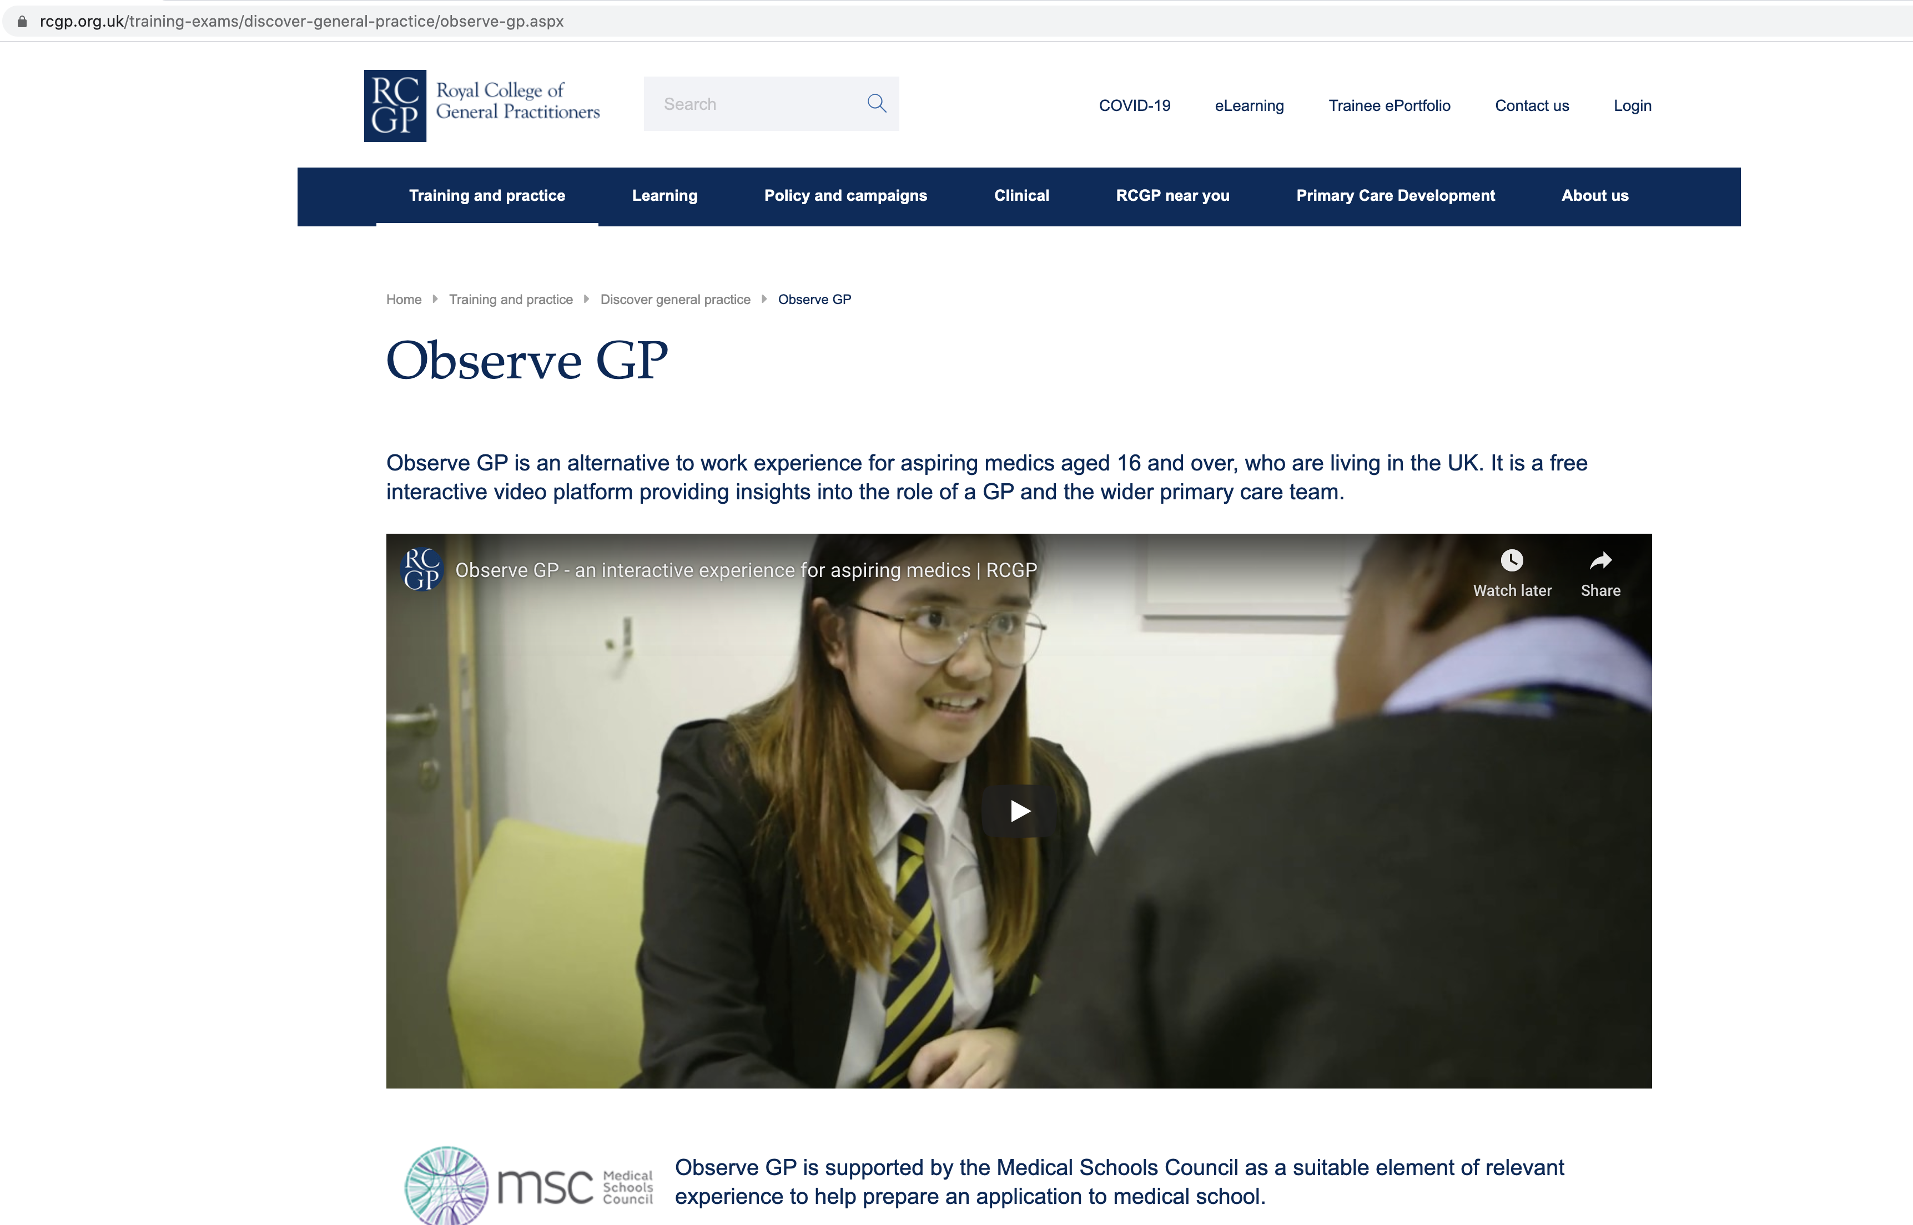

Slide 41
Early next term
Reduce choices to a short list
Make sure your choices match your results and predicted grades
Complete your personal statements
Oxbridge, Medics, Dentists & Vets should be already done
When you are happy with your form & people have checked it you should mark it complete, pay & send it to your referee

Slide 42
Your school reference
In early September all your subject teachers will complete a subject reference
These references will contain comments about your AS performance, subject knowledge, skills, personal qualities etc.
We will write your school reference from looking at these subject references, talking to your form tutor and from our own knowledge

Slide 43
Other support
Use tutors to go through personal statements etc.
Use subject teachers especially re subject specific issues
Your UCAS referee can give you additional guidance
UCAS website has loads of video clips showing how to complete the various sections of the form

Slide 45
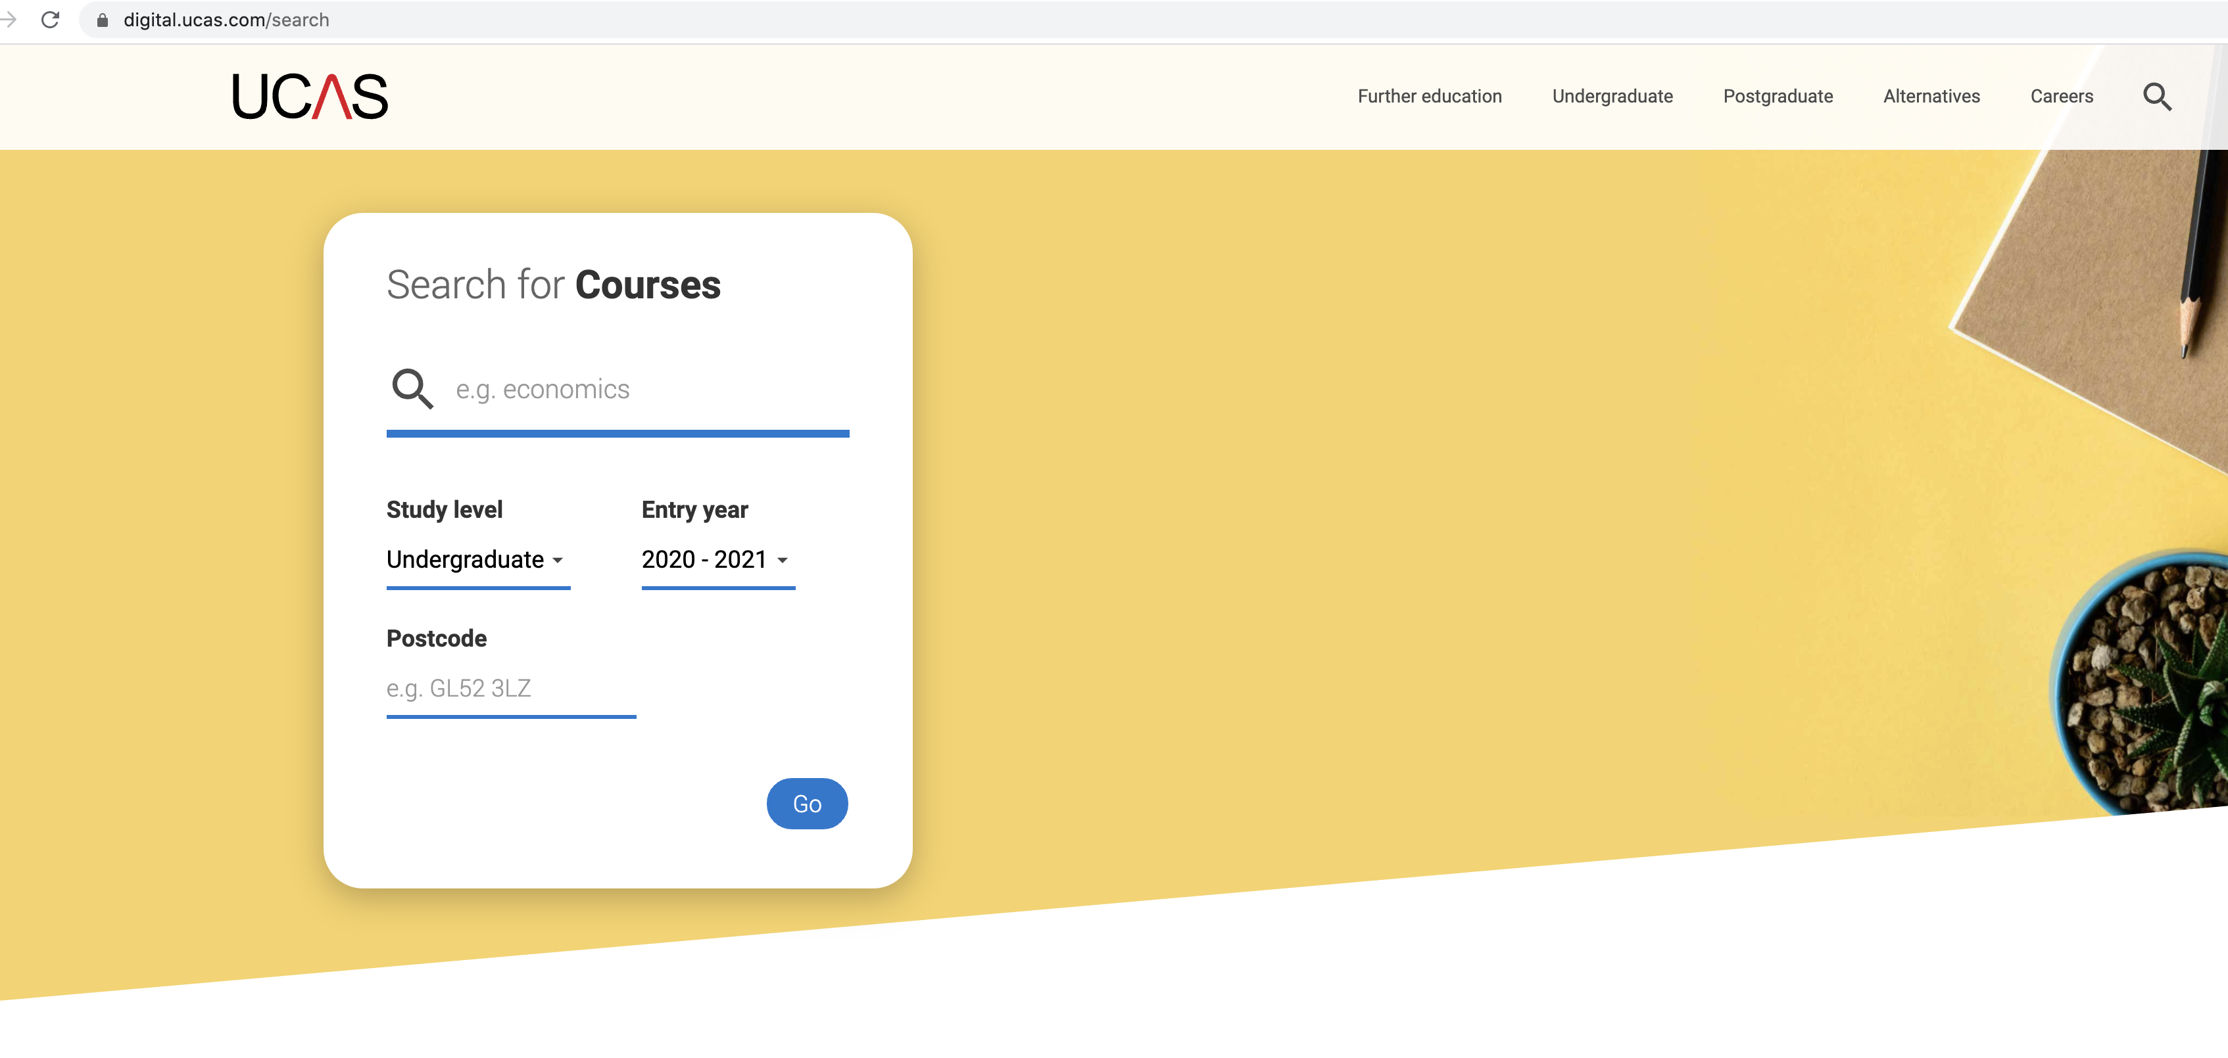
USE THE UCAS SEARCH TOOL https://digital.ucas.com/search

Slide 46
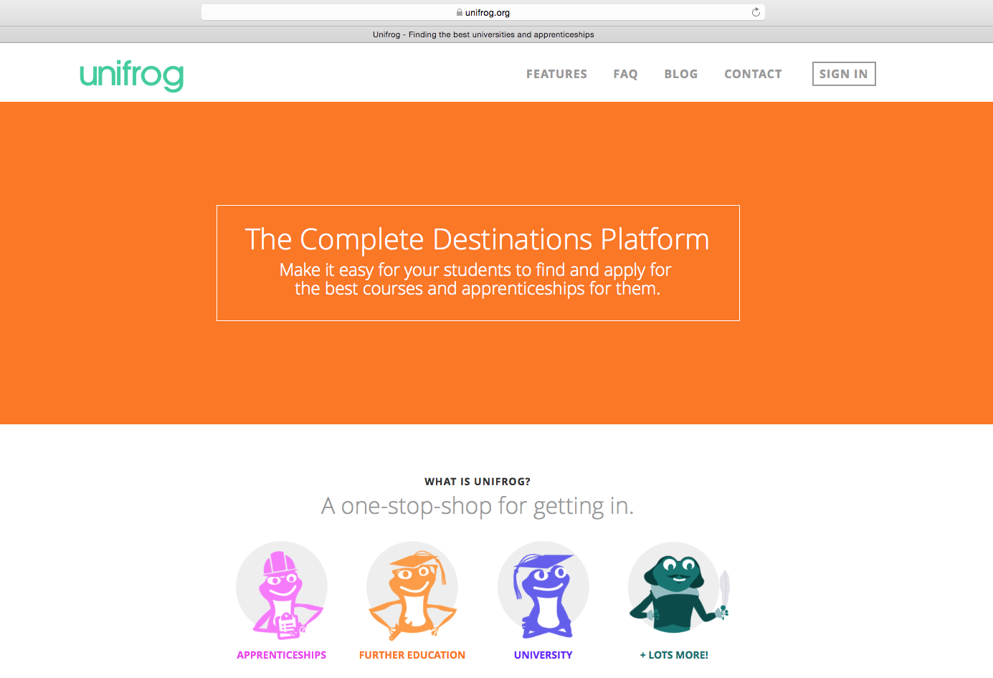

Slide 47
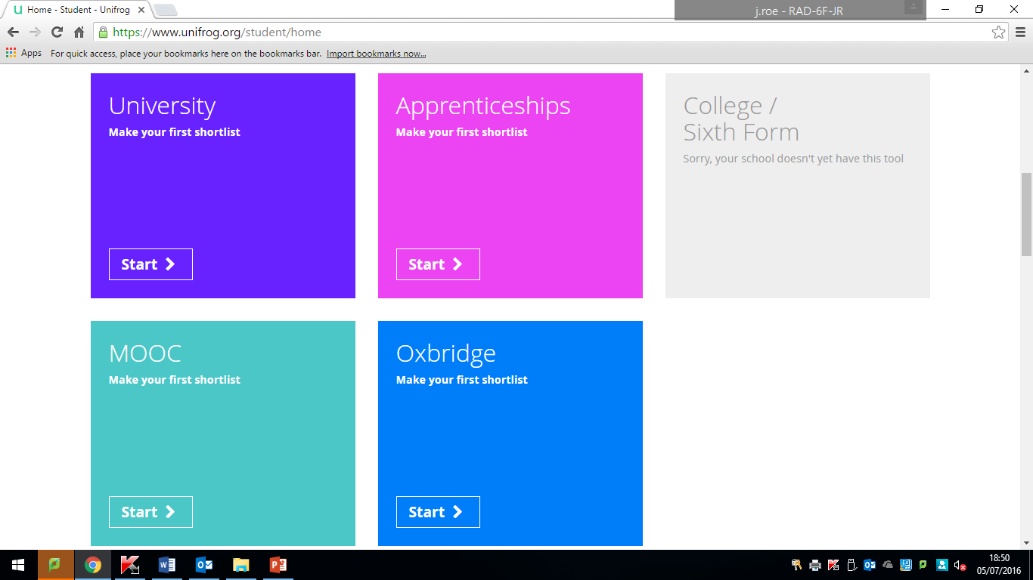

Slide 48
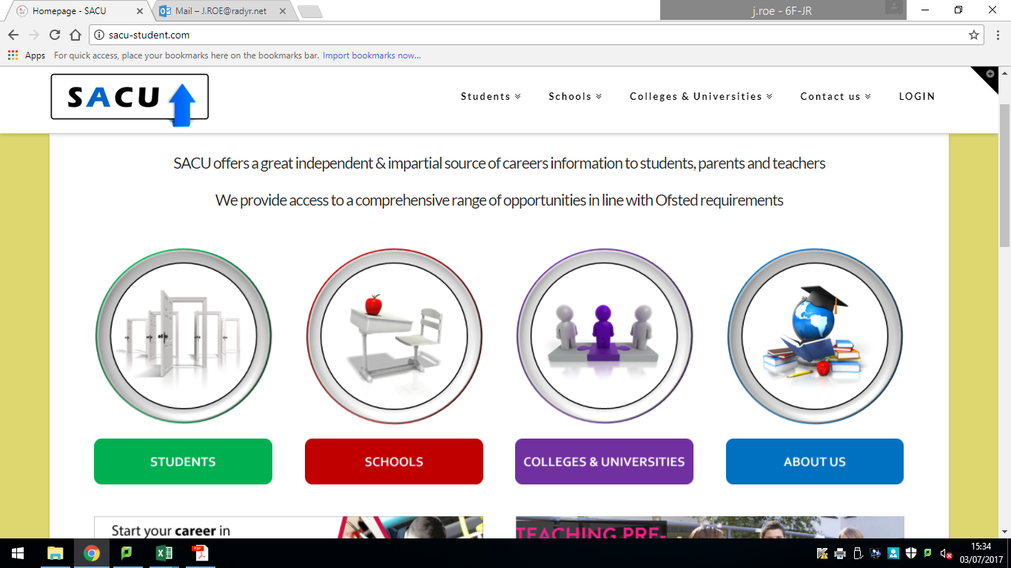

Slide 49
Anything else
Any extra exams BMAT etc. need booking and sitting
Students may need to prepare a piece of work to send off for certain courses.
Check to see if you will be required to attend an interview.

Slide 50
UCAS Conservatoires
Although you can apply for music or performing arts courses via UCAS. You may want to apply to Conservatoires which are outside of the UCAS scheme.
Please be aware that many of these courses have an earlier deadline of October and require references to be sent via post.
Anyone who is applying through this scheme will need to contact Miss Young before the end of the summer term and have their personal statement finished by Mid September.

Slide 52
Questions we don’t answer
Can you tell me which university I should go to ?
Can you tell me which course I should study?

Slide 53
Other Useful Resources
http://www.thecompleteuniversityguide.co.uk/
https://discoveruni.gov.uk
http://purepotential.org/
https://www.studential.com
https://www.whatuni.com
http://www.applytouni.com/

Slide 54
Question
Would you buy a house just from talking to an estate agent ?
Unlikely – you’d want to see it and see what it felt like first, visits are vital but try to see a little of the city as well as the university

