Slide 1
Higher Education in 2020
Steve Minney – Head of Undergraduate Recruitment

Slide 2


What differentiates applicants?
Predicted Grades / Reference
Resilience
Goals

Slide 3
Higher Education as a commodity
Tuition Fees – altered dynamic between applicant/HEI
Increasingly market oriented behavior on both sides
Shifts in demand across subjects/HEIs
Increased focus on student experience and outcome
Value for money – contact time
Economic Uncertainty
Growth of degree apprenticeships

Slide 4
Degree apprenticeships
Apprenticeships let you earn and learn simultaneously, from minimum wage up to £300 per week.
You’ll be a paid employee of a company, with a contract of employment and holiday entitlement.
Apprenticeships offer a package of work and study, where you’ll gain qualifications and hands-on experience while you work.
Employers including Deloitte, BMW and the BBC take on apprenticeships and opportunities span across sectors, from engineering to law.
There were more than 28,000 apprenticeship vacancies available in 2018, across more than 1,500 roles.
A degree apprenticeship is a relatively new type of apprenticeship, which leads to a full university degree, e.g. Swansea Airbus collaboration

Slide 5
What are Universities looking for?
Breadth of subjects & experience
Wider reading and genuine interest in the subject area – extended comfort zone
Evidence of independent learning & research
Project based qualification
Engagement with extracurricular activities
Academic record – resilience & ability

Slide 6
Skills
Admissions Tutors look for context/explanation of what skills you have gained and why they are relevant to your future study/career, for example:
Commitment Teamwork
Leadership Time management
Initiative Communication
Motivation Creativity

Slide 7
Go Global
Study Abroad
Volunteer Abroad
Research/Field Trips Overseas
Overseas Placements
Partner Institutions
At Swansea, all of our courses offer the opportunity to study abroad
Find out what your chosen institutions offer.) offer

Slide 8
Traditional subjects
e.g. Mathematics, History
Vocational
e.g. Cardiac Physiology, Pharmacy
Creative
e.g. Digital, Film/TV, Fashion

Slide 9
University Applications
450,000 applications to UK institutions in 2018
Around 150 Higher Education Institutions (HEIs) in the UK offering tens of thousands of courses including vocational, academic and more ‘individual.’

Slide 10



Choosing What and Where to Study
UCAS.com offers students the opportunity to search for every undergraduate course offered in the UK
You can search by institution and/or by course
Other online resources include:
HE Fairs – representatives from different institutions
WhichUni
University websites – request prospectuses , contact admissions tutors/enquiries teams

Slide 11


Resources/things to consider
League tables – compare courses and institutions throughout the UK

Slide 12

Things to think about – statistics/rankings
Graduate Employment Rate – what % of students are in a graduate role after leaving university? How does this compare to other institutions?
NSS – what are students themselves saying about the course(s)/university
TEF/REF – Teaching Excellence and Research Excellence – what are the credentials of the universities you’re looking at?
Courses
Module Options – research into the courses you’re interested in to find out what areas you can study – all courses will vary between institutions
Assessment Methods – are there examinations? Course work? Group work? Look into the different methods of assessment for the course(s) you’re interested in
Facilities
Teaching Facilities – lecture theatres, laboratories, group study areas, seminar rooms, library and information centres, student ‘hubs’,
Accommodation – on or off campus, costs, parking, WiFi, security/safety, accessibility, additional requirements
Other Facilities – shops, eateries, doctor/dentist surgery, parking, open spaces, sport facilities
Student Services – career/employability services, Students’ Union, wellbeing

Slide 13

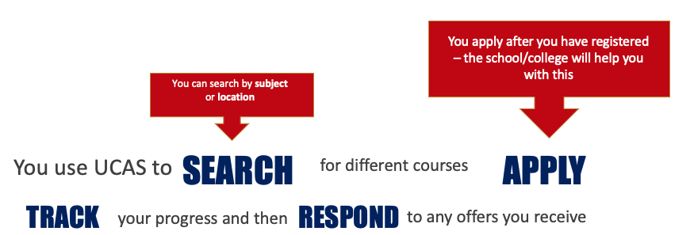
What is UCAS?
Universities and Colleges Admissions Service
Main role is to operate undergraduate
applications to universities throughout the UK
Applications are submitted online
https://www.ucas.com/undergraduate/applying-university/filling-your-ucas-undergraduate-application
Use tutorial videos

Slide 14
Submitting and Receiving Offers
Universities will respond at various times – you receive these offers via the UCAS portal (‘track’)
If you submit your application by January 15, universities have until May 2 to provide their offers
Access all offers via the UCAS track system

Slide 15
Offers
Once the application is submitted, universities will start to respond via UCAS track
Unsuccessful – you have not received an offer to study on that course
‘Extra’ – if you do not receive any offers you may be eligible for UCAS Extra – this is a free service and you can apply for one course at a time between February and July
Clearing – if you do not achieve any of your offers, you may be eligible for ‘clearing’ - you then apply directly to the university for this after your results in August
CONDITIONAL
UNCONDITIONAL
You have to achieve certain results in order to attain a place at the university
E.g. ‘achieve AAB’ at A Level
Some universities guarantee a conditional offer of study once you have applied
You have already met the conditions/requirements of the course and have received a place
There are no further requirements

Slide 16
Responding to university offers
Firm Acceptance – This is your first choice course – if you received an unconditional offer then the place is already yours! If you received a conditional, then the place is yours if you achieve those conditions (e.g. you were told you had to obtain A,B,B at A Level). If you do not achieve those, then you can go to your insurance…
Insurance Acceptance - Insurance acceptances are typically courses that have made you a lower offer – you only attend your insurance (e.g. you were told you had to obtain B,B,B at A Level)
Universities’ discretion – ultimately Admissions Tutors make the decision
Declines - You will have to decline any other offers
For more information about offers and responses, visit ucas.com

Slide 17
Resources/Suggestions
UCAS.com – where you search for courses, have access to videos/tutorials, submit your application and respond to offers – also plenty of personal statement guidance and advice – think about the skills you’re gaining in school/outside of school that you can use for your personal statement
The Student Room – online forum for prospective and current students, different forum areas depending on what and where you’re studying
WhatUni – impartial ‘reviews’ of various aspects of university life, from courses and accommodation to nightlife and local areas
Universities’ Websites – request hard copies of prospectuses, attend virtual tours/open days, research scholarships/bursaries, contact Admissions Tutors with any questions
Open Days – get a ‘feel’ for the university – allow plenty of time
Student Finance Wales – familiarize yourself with the Student Finance Wales website should you be wanting to apply for financial support
Social Media – ‘follow’ universities on social media to find out about recent research undertaken, events, etc.

Slide 18
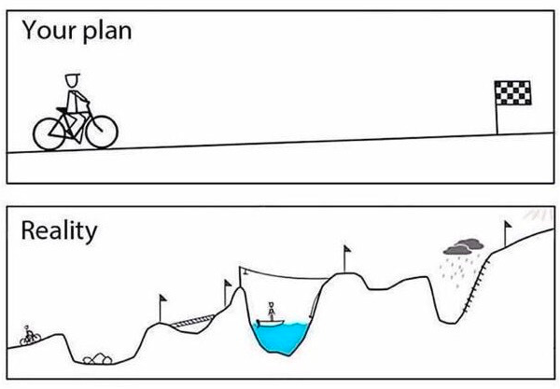
The Rocky Road?

Slide 19
Undergraduate Open Days 2019
Saturday 19th October
Saturday 16th November
Any questions?
Email s.n.minney@swansea.ac.uk

